Slide 1
CHM-DSC-151
UNIT-4
STEREOCHEMISTRY
AND CONFORMATION ANALYSIS
BY:
JNYANASHREE DARABDHARA

Slide 2
Stereochemistry
Projections of organic molecules.
Flying wedge
Saw-horse
Newman
Fischer
Sawhorse Projections:
There are two types of Y
erect
inverted
Staggered
Esclipsed

Slide 3
B,F is towards the observer
E,C is away from the observer
A,D in plane
B,D is towards observer
A,F away from observer
C,E in plane
B,D towards the observer
F,C away from observer
E,A in plane
B,D towards the observer
F,C away from the observer
A,E in plane
Conversion of one sawhorse to another
The C-C bond is kept constant during the conversion
We will fix one carbon and rotate the other carbon by 120°, 180° and 60° and observer the changes in the nature of Y’s.
120°
60°
180°
120° rotation no change in the nature of Y.
180° and 60° rotation the Y nature changes

Slide 4
Z axis
Rotation around Z axis
Application:
A and C are syn. Syn occurs in eclipsed configuration
A and C are anti. Anti occurs in staggered configuration
NaI, Acetone
120° around C1, 60° around C2
trans

Slide 5
Newman Representation
U-Up, R-Right, B-Back, F-Front, L-left, D-Down
Erect-inverted
Inverted-erect
Inverted-inverted
Erect-erect
The conversion of one newman to another is similar to the conversions in saw-horse
120° rotation around the front carbon
60° rotation around the back carbon
Ξ
A,Q are anti
or
A,Q are syn

Slide 6
Fischer Representation
Vertical line means away from the observer
Horizontal line means towards the observer
In Fischer the maximum number of carbon atom should lie on line
The most oxidized group should lie at the top and least oxidized group should be at the bottom
Ξ
Conversion of one fisher to another Fischer representation
In fisher in plane rotation is allowed, out of plane rotation is restricted
By keeping one bond constant we can rotate the other three groups by angles of n multiples of 120°.
Ξ
Ξ
180° around Z axis

Slide 7
Not allowed
180° around Y axis, out of plane rotation
Ξ
During the rotation the bond between the Carbon atoms was kept constant.
Ξ
180° around Z axis, diagonal rotation
Saw-horse to newman:
Newman to sawhorse
Ξ
Ξ

Slide 8
Saw-horse to Fischer
Press it from top
Legs are converted to vertical and arms are converted to horizontal line
Ξ
Only erect-erect form will convert to fisher.
Ξ

Slide 9
Fischer to saw-horse:
Ξ
Ξ
180° rotation at C2
NaI, acetone
Convert to erect-erect sawhorse and then do the elimination
Newmann to Fischer:
This conversion is similar to sawhorse to newmann. Onle the erect-erect form will convert to fischer
Ξ
Fischer to Newman:
Ξ
Ξ

Slide 10

Application
C2H5ONa
Ξ
Saw-horse to wedge
Ξ
Syn
Anti
Ξ

Slide 11
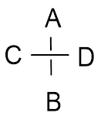
Wedge to saw-horse:
Ξ
Fischer to Flying wedge:
Ξ
Ξ
Ξ
Ξ
Wavy line means the configuration is not defined
A,R are syn
A,D are anti

Slide 12
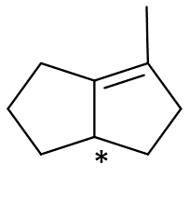
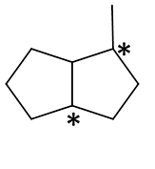
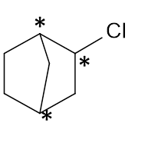
Asymmetric centre
All the four groups attached to the asymmetric center should be different
The hybridization of the asymmetric center (C atom) should be sp³
No asymmetric center
*
*
R and S nomemclature in organic molecules:
R mean Rectus
S mean Sinister
We will name R and S nomenclature based on the CIP rule.

Slide 13
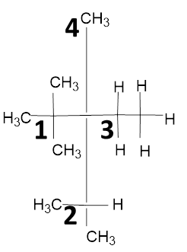
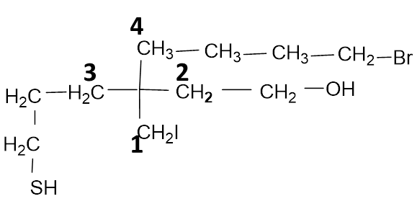
CIP rule:
The directly attached atom to the asymmetric center having high atomic number will get more priority. In case of isotopes, the isotope with high atomic mass will get more priority.
Examples:
Priority sequence: Br>Cl>F>H
Priority sequence: F>T>D>H
Important:
(C,C,C) , (6+6+6=18) Do not look in this way
(N,H,H), (14+1+1)=9)
Instead look as (C,C,C)= C
(N,H,H)=N
As N has more atomic number then C so (N,H,H) has more priority over (C,C,C)

Slide 14
In case of double bond and triple bond they become duplicated and triplicated.
Examples:
By duplication
Do similar with
(O,O,H)
R and S nomenclature in wedge systems:
Assign the asymmetric center
Put the CIP rule
The fourth priority group should be always away from the observe. Then move 1-2-3, if the movement is clockwise then R, if anti-clockwise then S
If the fourth priority group is towards the observer move 1-2-3, if movement is clockwise then S, if movement is anti-clock wise the R
Clockwise movement
Anticlockwise movement

Slide 15
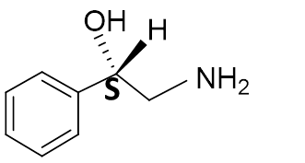
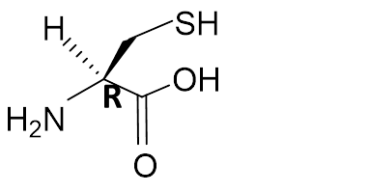
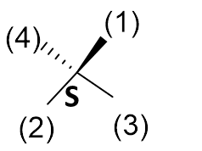
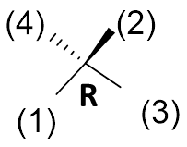
If the fourth priority group is on plane, then do double interchange and determine the R and S.
Examples:
Ξ
Ξ
Ξ

Slide 16
THANK YOU

