Slide 1

Symmetric and Skew symmetric Matrices
NEP-2020::FYUG –1st & 3rd Semester
DSC-101T/SEC-101T/DSM-201T
Dr. Md. Helal Ahmed
Assistant Professor
Department of Mathematics
Haflong Govt. College
Haflong, Dima Hasao, Assam-788819

Slide 2
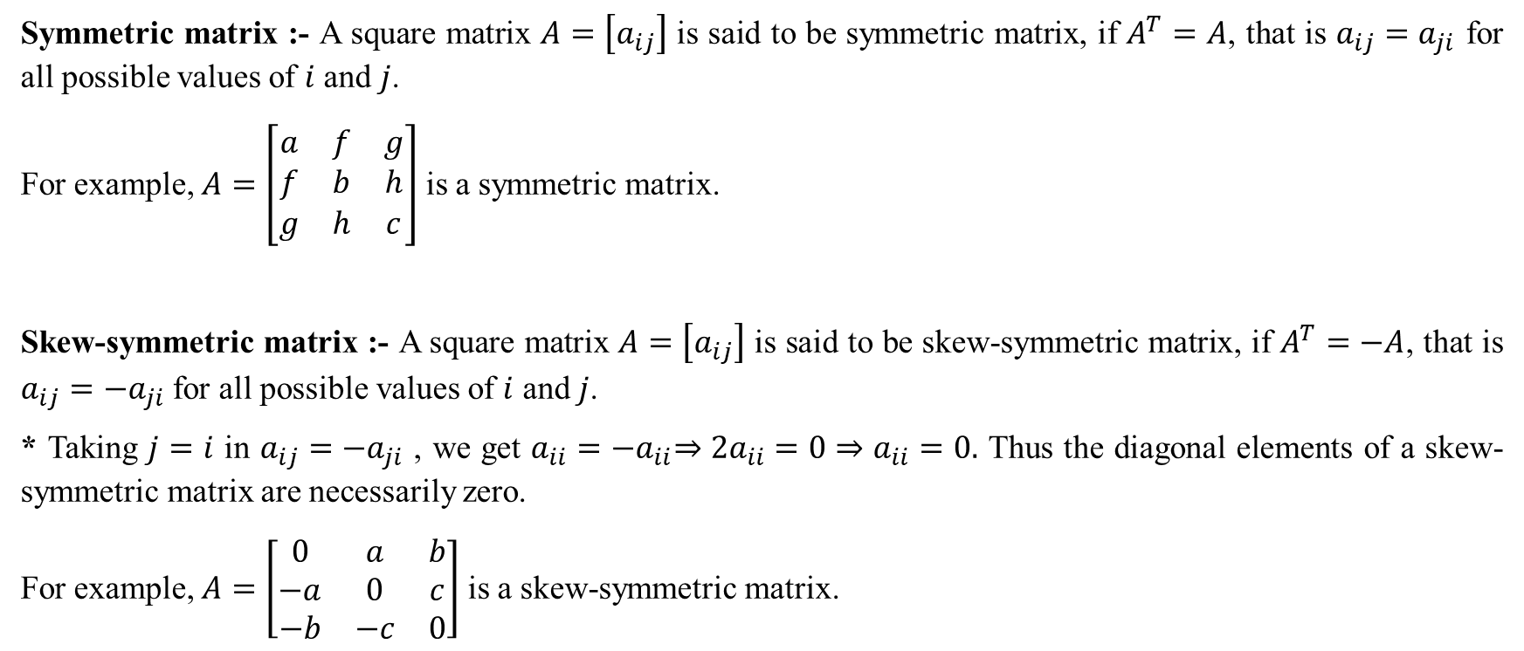
Symmetric matrix :- A square matrix $A=\left[a_{ij}\right]$ is said to be symmetric matrix, if $A^{T}=A$, that is $a_{ij}=a_{ji}$ for all possible values of $i$ and $j$.
For example, $A=\left[\begin{matrix}a & f & g \\ f & b & h \\ g & h & c\end{matrix}\right]$ is a symmetric matrix.
Skew-symmetric matrix :- A square matrix $A=\left[a_{ij}\right]$ is said to be skew-symmetric matrix, if $A^{T}=−A$, that is $a_{ij}={−a}_{ji}$ for all possible values of $i$ and $j$.
* Taking $j=i$ in $a_{ij}={−a}_{ji}$ , we get $a_{ii}={−a}_{ii}⇒2a_{ii}=0⇒a_{ii}=0.$ Thus the diagonal elements of a skew-symmetric matrix are necessarily zero.
For example, $A=\left[\begin{matrix}0 & a & b \\ −a & 0 & c \\ −b & −c & 0\end{matrix}\right]$ is a skew-symmetric matrix.

Slide 3
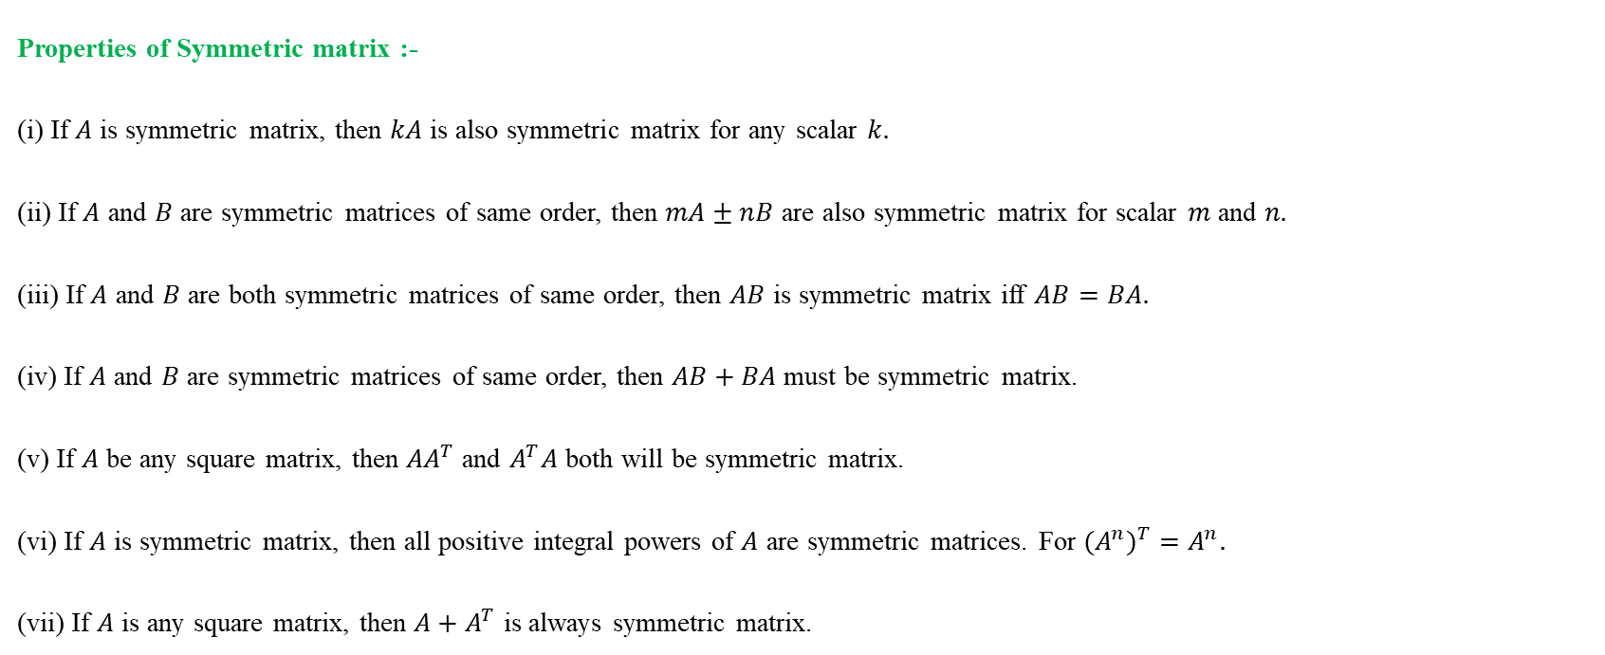
Properties of Symmetric matrix :-
(i) If $A$ is symmetric matrix, then $kA$ is also symmetric matrix for any scalar $k.$
(ii) If $A$ and $B$ are symmetric matrices of same order, then $mA±nB$ are also symmetric matrix for scalar $m$ and $n.$
(iii) If $A$ and $B$ are both symmetric matrices of same order, then $AB$ is symmetric matrix iff $AB=BA.$
(iv) If $A$ and $B$ are symmetric matrices of same order, then $AB+BA$ must be symmetric matrix.
(v) If $A$ be any square matrix, then ${AA}^{T}$ and $A^{T}A$ both will be symmetric matrix.
(vi) If $A$ is symmetric matrix, then all positive integral powers of $A$ are symmetric matrices. For ${{(A}^{n})}^{T}=A^{n}.$
(vii) If $A$ is any square matrix, then ${A+A}^{T}$ is always symmetric matrix.

Slide 4
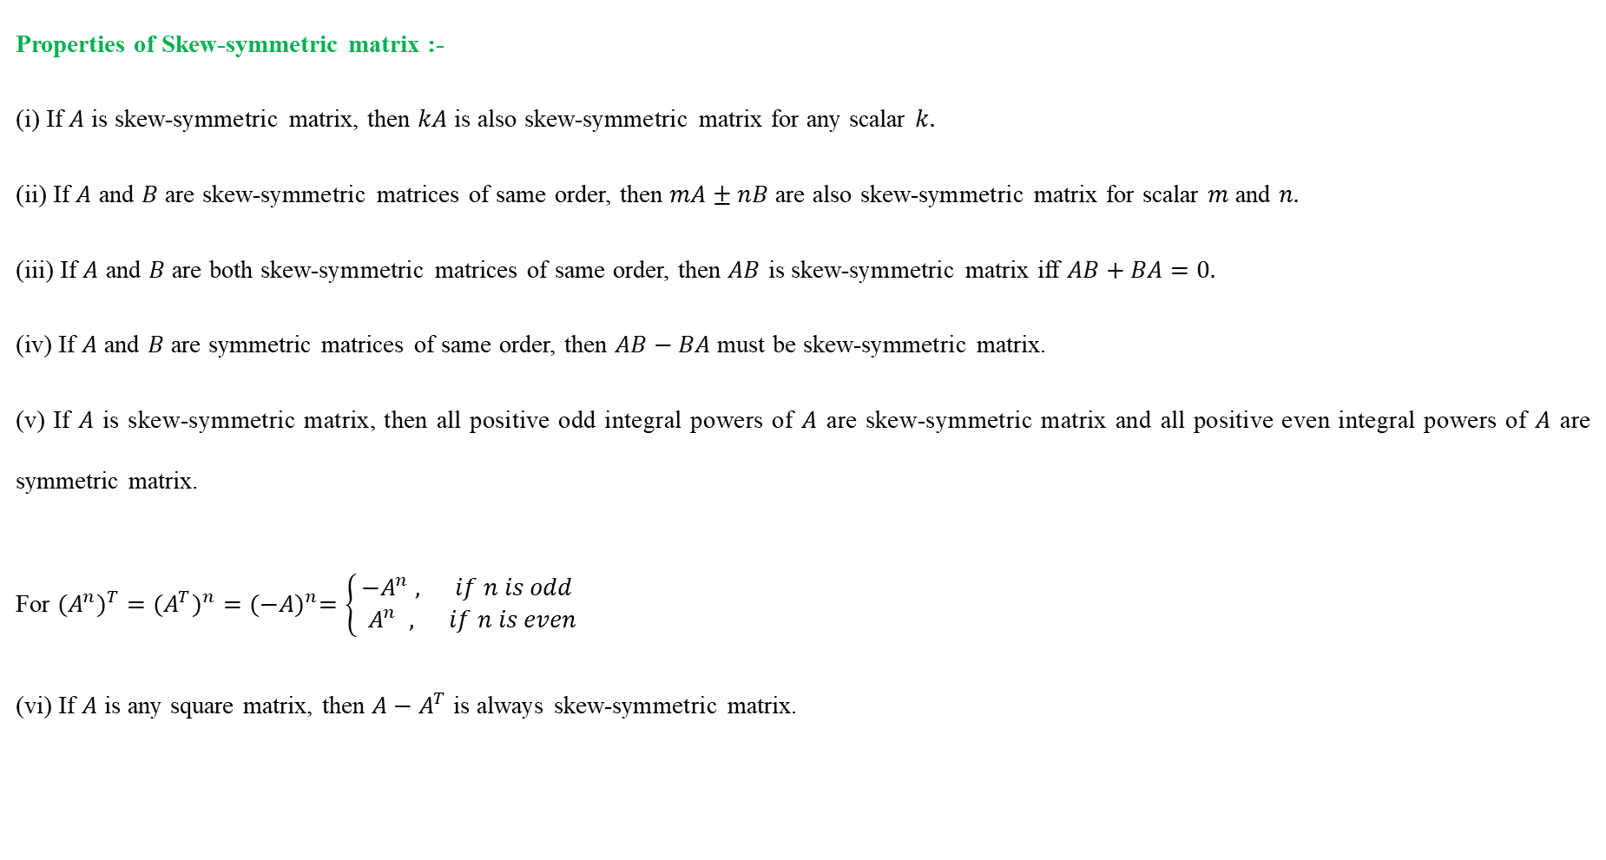
Properties of Skew-symmetric matrix :-
(i) If $A$ is skew-symmetric matrix, then $kA$ is also skew-symmetric matrix for any scalar $k.$
(ii) If $A$ and $B$ are skew-symmetric matrices of same order, then $mA±nB$ are also skew-symmetric matrix for scalar $m$ and $n.$
(iii) If $A$ and $B$ are both skew-symmetric matrices of same order, then $AB$ is skew-symmetric matrix iff $AB+BA=0.$
(iv) If $A$ and $B$ are symmetric matrices of same order, then $AB−BA$ must be skew-symmetric matrix.
(v) If $A$ is skew-symmetric matrix, then all positive odd integral powers of $A$ are skew-symmetric matrix and all positive even integral powers of $A$ are symmetric matrix.
For ${{(A}^{n})}^{T}={{(A}^{T})}^{n}={(−A)}^{n}=\left\{\begin{aligned}−A^{n} , if n is odd \\ { A}^{n} , if n is even\end{aligned}\right.$
(vi) If $A$ is any square matrix, then ${A−A}^{T}$ is always skew-symmetric matrix.

Slide 5

Q. For any square matrix $A$ with real entries, ${A+A}^{T}$ is a symmetric matrix and ${A−A}^{T}$ is a skew symmetric matrix.
Solution. Let ${B=A+A}^{T},$ then
$$B^{T}={\left({A+A}^{T} \right)}^{T}$$
$${ =A}^{T}+{{(A}^{T})}^{T} (∵ {(A+B)}^{T}=A^{T}+B^{T})$$
$${ =A}^{T}+A (∵ {{(A}^{T})}^{T}=A)$$
$${ =A+A}^{T} (∵A+B=B+A)$$
$=B$
Therefore ${B=A+A}^{T}$ is a symmetric matrix.
Now let ${C=A−A}^{T},$ then
$$C^{T}={\left({A−A}^{T} \right)}^{T}$$
$${ =A}^{T}−{{(A}^{T})}^{T} (∵ {(A+B)}^{T}=A^{T}+B^{T})$$
$${ =A}^{T}−A (∵ {{(A}^{T})}^{T}=A)$$
$${ =−(A−A}^{T})$$
$=−C$
Therefore ${C=A−A}^{T}$ is a skew symmetric matrix.

Slide 6
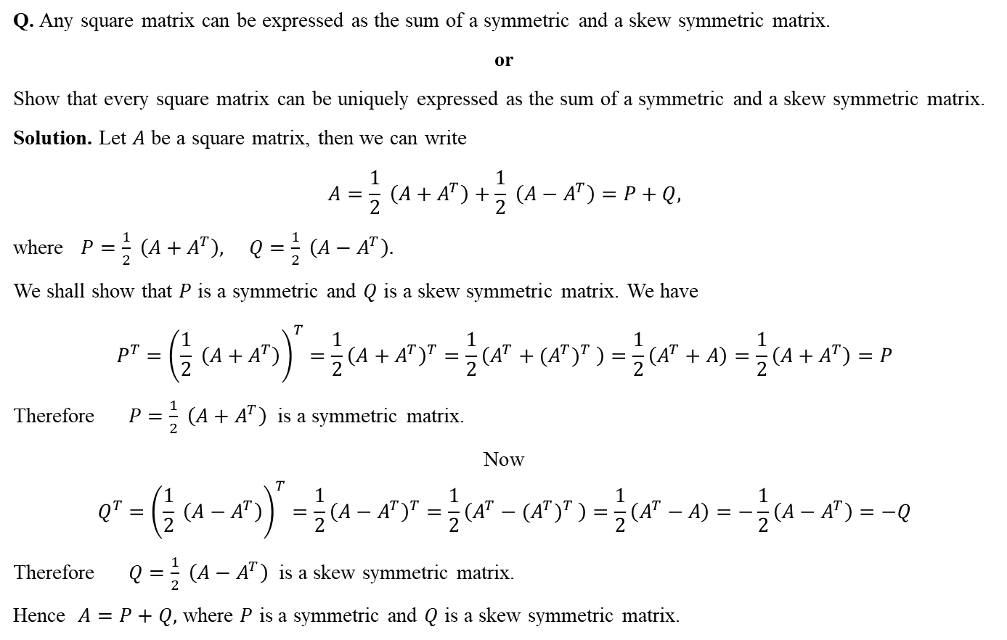
Q. Any square matrix can be expressed as the sum of a symmetric and a skew symmetric matrix.
or
Show that every square matrix can be uniquely expressed as the sum of a symmetric and a skew symmetric matrix.
Solution. Let $A$ be a square matrix, then we can write
$$A=\frac{1}{2} \left({A+A}^{T}\right)+\frac{1}{2} \left({A−A}^{T}\right)=P+Q,$$
where $P=\frac{1}{2} \left({A+A}^{T}\right), Q=\frac{1}{2} \left({A−A}^{T}\right).$
We shall show that $P$ is a symmetric and $Q$ is a skew symmetric matrix. We have
$$P^{T}={\left(\frac{1}{2} \left({A+A}^{T}\right)\right)}^{T}={\frac{1}{2}\left({A+A}^{T}\right)}^{T}=\frac{1}{2}\left(A^{T}+{{(A}^{T})}^{T} \right)=\frac{1}{2}\left(A^{T}+A\right)=\frac{1}{2}\left({A+A}^{T}\right)=P$$
Therefore $P=\frac{1}{2} \left({A+A}^{T}\right)$ is a symmetric matrix.
Now $$Q^{T}={\left(\frac{1}{2} \left({A−A}^{T}\right)\right)}^{T}={\frac{1}{2}\left({A−A}^{T}\right)}^{T}=\frac{1}{2}\left(A^{T}−{{(A}^{T})}^{T} \right)=\frac{1}{2}\left(A^{T}−A\right)=−\frac{1}{2}\left({A−A}^{T}\right)=−Q$$
Therefore $Q=\frac{1}{2} \left({A−A}^{T}\right)$ is a skew symmetric matrix.
Hence $A=P+Q,$ where $P$ is a symmetric and $Q$ is a skew symmetric matrix.

Slide 7
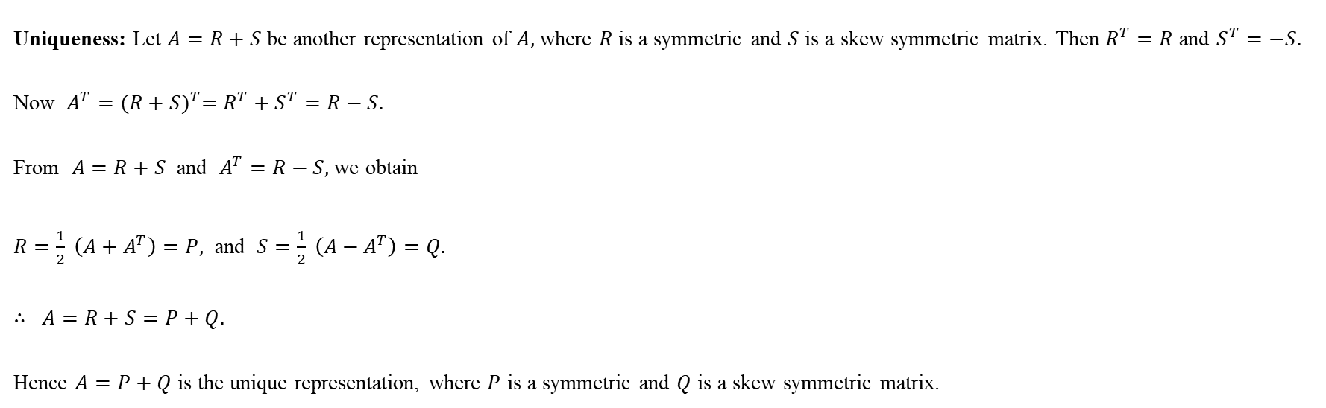
Uniqueness: Let $A=R+S$ be another representation of $A,$ where $R$ is a symmetric and $S$ is a skew symmetric matrix. Then $R^{T}=R$ and $S^{T}=−S.$
Now $A^{T}={(R+S)}^{T}=R^{T}+S^{T}=R−S.$
From $A=R+S$ and $A^{T}=R−S,$ we obtain
$R=\frac{1}{2} \left({A+A}^{T}\right)=P,$ and $S=\frac{1}{2} \left({A−A}^{T}\right)=Q.$
$∴ A=R+S=P+Q.$
Hence $A=P+Q$ is the unique representation, where $P$ is a symmetric and $Q$ is a skew symmetric matrix.

Slide 8
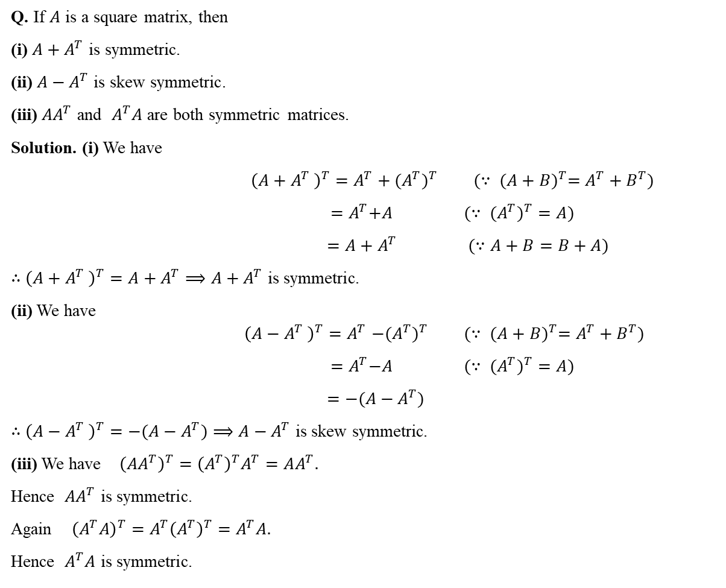
Q. If $A$ is a square matrix, then
(i) ${A+A}^{T}$ is symmetric.
(ii) ${A−A}^{T}$ is skew symmetric.
(iii) ${AA}^{T}$ and $A^{T}A$ are both symmetric matrices.
Solution. (i) We have
${\left({A+A}^{T} \right)}^{T}=A^{T}+{{(A}^{T})}^{T} (∵ {(A+B)}^{T}=A^{T}+B^{T})$
$${ =A}^{T}+A (∵ {{(A}^{T})}^{T}=A)$$
$${ =A+A}^{T} (∵A+B=B+A)$$
$∴$ ${\left({A+A}^{T} \right)}^{T}={A+A}^{T}{⟹A+A}^{T}$ is symmetric.
(ii) We have $${\left({A−A}^{T} \right)}^{T}{=A}^{T}−{{(A}^{T})}^{T} (∵ {(A+B)}^{T}=A^{T}+B^{T})$$
$${ =A}^{T}−A (∵ {{(A}^{T})}^{T}=A)$$
$${ =−(A−A}^{T})$$
$∴$ ${\left({A−A}^{T} \right)}^{T}={−(A−A}^{T}){⟹A−A}^{T}$ is skew symmetric.
(iii) We have ${\left({AA}^{T}\right)}^{T}={\left(A^{T}\right)}^{T}A^{T}=AA^{T}.$
Hence ${AA}^{T}$ is symmetric.
Again ${\left(A^{T}A\right)}^{T}={A^{T}\left(A^{T}\right)}^{T}=A^{T}A.$
Hence $A^{T}A$ is symmetric.

Slide 9
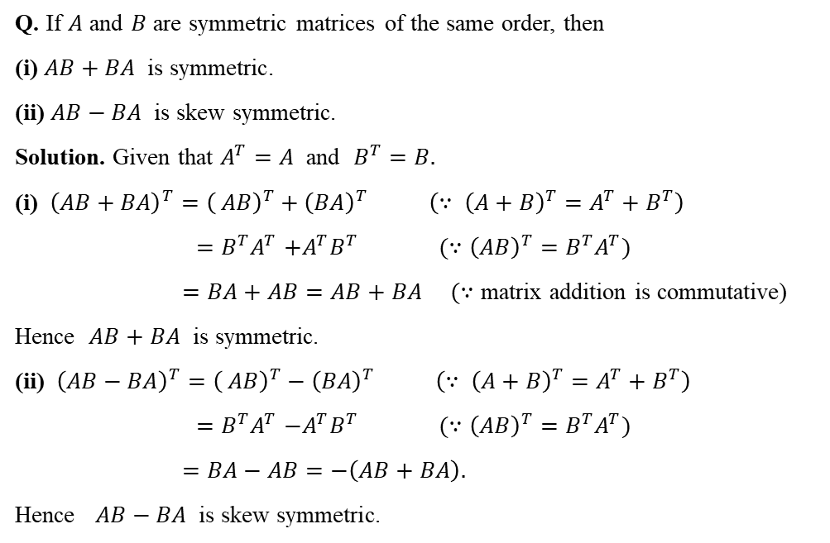
Q. If $A$ and $B$ are symmetric matrices of the same order, then
(i) $AB+BA$ is symmetric.
(ii) $AB−BA$ is skew symmetric.
Solution. Given that $A^{T}=A$ and $B^{T}=B.$
(i) ${\left(AB+BA\right)}^{T}={\left( AB\right)}^{T}+{\left(BA\right)}^{T}$ $\left(∵ {\left(A+B\right)}^{T}=A^{T}+B^{T}\right)$
${=B^{T}A}^{T}+A^{T}B^{T} (∵{\left(AB\right)}^{T}{=B^{T}A}^{T})$
$=BA+AB=AB+BA$ $(∵$ matrix addition is commutative)
Hence $AB+BA$ is symmetric.
(ii) ${\left(AB−BA\right)}^{T}={\left( AB\right)}^{T}−{\left(BA\right)}^{T}$ $\left(∵ {\left(A+B\right)}^{T}=A^{T}+B^{T}\right)$
${=B^{T}A}^{T}−A^{T}B^{T} (∵{\left(AB\right)}^{T}{=B^{T}A}^{T})$
$=BA−AB=−\left(AB+BA\right).$
Hence $AB−BA$ is skew symmetric.

Slide 10
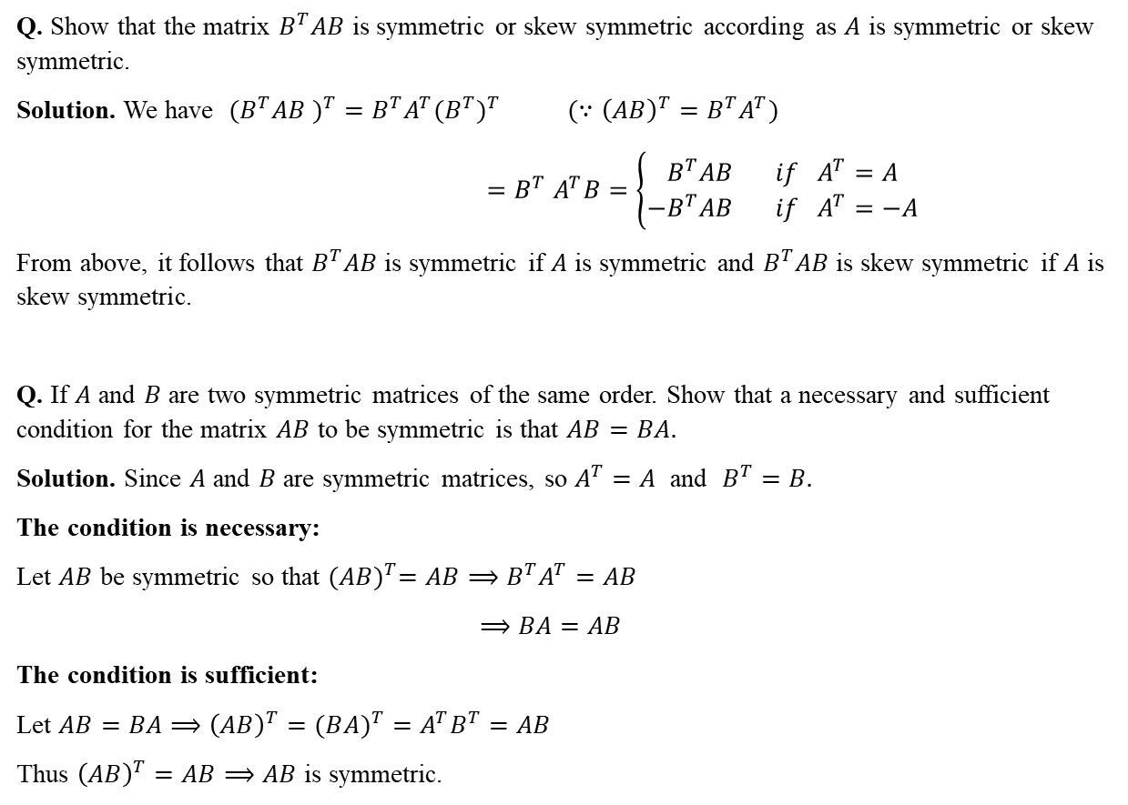
Q. Show that the matrix $B^{T}AB$ is symmetric or skew symmetric according as $A$ is symmetric or skew symmetric.
Solution. We have $({B^{T}AB )}^{T}=B^{T}A^{T}{(B^{T})}^{T}$ $(∵{\left(AB\right)}^{T}{=B^{T}A}^{T})$
$${=B}^{T}A^{T}B=\left\{\begin{aligned}B^{T}AB if A^{T}=A \\ {−B}^{T}AB if A^{T}=−A\end{aligned}\right.$$
From above, it follows that $B^{T}AB$ is symmetric if $A$ is symmetric and $B^{T}AB$ is skew symmetric if $A$ is skew symmetric.
Q. If $A$ and $B$ are two symmetric matrices of the same order. Show that a necessary and sufficient condition for the matrix $AB$ to be symmetric is that $AB=BA.$
Solution. Since $A$ and $B$ are symmetric matrices, so $A^{T}=A$ and $B^{T}=B.$
The condition is necessary:
Let $AB$ be symmetric so that ${(AB)}^{T}=AB⟹B^{T}A^{T}=AB$
$$⟹BA=AB$$
The condition is sufficient:
Let $AB=BA⟹{\left(AB\right)}^{T}=(B{A)}^{T}=A^{T}B^{T}=AB$
Thus ${\left(AB\right)}^{T}=AB⟹AB$ is symmetric.

Slide 11
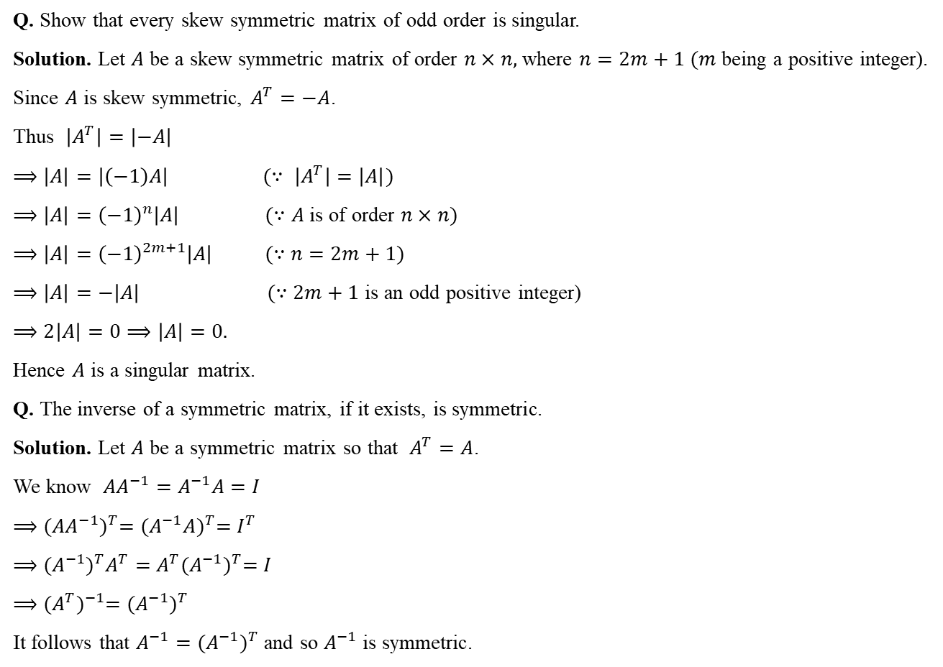
Q. Show that every skew symmetric matrix of odd order is singular.
Solution. Let $A$ be a skew symmetric matrix of order $n×n,$ where $n=2m+1 (m$ being a positive integer).
Since $A$ is skew symmetric, $A^{T}=−A$.
Thus $\left|A^{T}\right|=\left|−A\right|$
$⟹\left|A\right|=\left|\left(−1\right)A\right| (∵ \left|A^{T}\right|=\left|A\right|)$
$⟹\left|A\right|={\left(−1\right)}^{n}\left|A\right| (∵A$ is of order $n×n)$
$⟹\left|A\right|={\left(−1\right)}^{2m+1}\left|A\right| (∵$ $n=2m+1)$
$⟹\left|A\right|=−\left|A\right| (∵2m+1$ is an odd positive integer)
$⟹2\left|A\right|=0⟹\left|A\right|=0.$
Hence $A$ is a singular matrix.
Q. The inverse of a symmetric matrix, if it exists, is symmetric.
Solution. Let $A$ be a symmetric matrix so that $A^{T}=A$.
We know ${AA}^{−1}=A^{−1}A=I$
$⟹{({AA}^{−1})}^{T}={(A^{−1}A)}^{T}=I^{T}$
$⟹{(A^{−1})}^{T}A^{T}=A^{T}{(A^{−1})}^{T}=I$
$⟹{{(A^{T})}^{−1}=(A^{−1})}^{T}$
It follows that $A^{−1}={(A^{−1})}^{T}$ and so $A^{−1}$ is symmetric.

Slide 12

Q. Prove that $A$ and $B$ are non-singular symmetric matrices such that $AB=BA,$ then ${AB}^{−1}, A^{−1}B, A^{−1}B^{−1}$ are also symmetric.
Solution. Since $A$ and $B$ are non-singular, $A^{−1}$ and $B^{−1}$ exist. Since $A$ and $B$ are symmetric, (i.e., $A^{T}=A$ and $B^{T}=B)$ so $A^{−1}$ and $B^{−1}$ are also symmetric matrices (i.e., $A^{−1}={(A^{−1})}^{T}$ and $B^{−1}={(B^{−1})}^{T}$).
Now $AB=BA⟹{\left(AB\right)}^{−1}=({BA)}^{−1}{⟹B}^{−1}A^{−1}=A^{−1}B^{−1}$ (1)
Again $A^{−1}B^{−1}=B^{−1}A^{−1}⟹{(A}^{−1}B^{−1})A={(B}^{−1}A^{−1})A$
$⟹{(A}^{−1}B^{−1})A=B^{−1}(A^{−1}A)$
$⟹{(A}^{−1}B^{−1})A=B^{−1}I$
$⟹{(A}^{−1}B^{−1})A=B^{−1}$
$⟹{A(A}^{−1}B^{−1})A={AB}^{−1}$
$⟹{(AA}^{−1})B^{−1}A={AB}^{−1}$
$⟹B^{−1}A={AB}^{−1}$ (2)
and $A^{−1}B^{−1}=B^{−1}A^{−1}⟹{(A}^{−1}B^{−1})B={(B}^{−1}A^{−1})B$
$⟹A^{−1}{(B}^{−1}B)=B^{−1}(A^{−1}B)$
$⟹A^{−1}I=B^{−1}(A^{−1}B)$
$⟹A^{−1}=B^{−1}(A^{−1}B)$
$⟹{BA}^{−1}={BB}^{−1}(A^{−1}B)$
$⟹{BA}^{−1}=I(A^{−1}B)$
$⟹{BA}^{−1}=A^{−1}B$ (3)
Now ${({AB}^{−1})}^{T}={(B^{−1})}^{T}A^{T}=B^{−1}A={AB}^{−1},$ using (2).
Hence ${AB}^{−1}$ is symmetric.

Slide 13
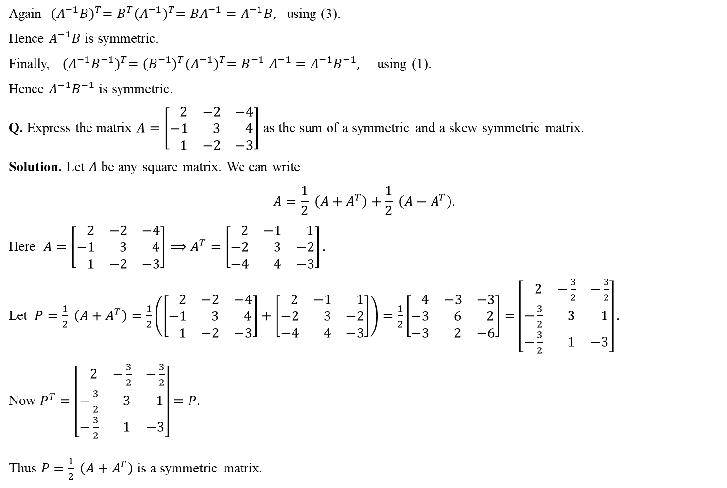
Again ${(A^{−1}B)}^{T}=B^{T}{(A^{−1})}^{T}={BA}^{−1}=A^{−1}B,$ using (3).
Hence $A^{−1}B$ is symmetric.
Finally, ${(A^{−1}B^{−1})}^{T}={(B^{−1})}^{T}{(A^{−1})}^{T}{=B}^{−1}A^{−1}=A^{−1}B^{−1},$ using (1).
Hence $A^{−1}B^{−1}$ is symmetric.
Q. Express the matrix $A=\left[\begin{matrix} 2 & −2 & −4 \\ −1 & 3 & 4 \\ 1 & −2 & −3\end{matrix}\right]$ as the sum of a symmetric and a skew symmetric matrix.
Solution. Let $A$ be any square matrix. We can write
$$A=\frac{1}{2} \left({A+A}^{T}\right)+\frac{1}{2} \left({A−A}^{T}\right).$$
Here $A=\left[\begin{matrix} 2 & −2 & −4 \\ −1 & 3 & 4 \\ 1 & −2 & −3\end{matrix}\right]⟹A^{T}=\left[\begin{matrix} 2 & −1 & 1 \\ −2 & 3 & −2 \\ −4 & 4 & −3\end{matrix}\right].$
Let $P=\frac{1}{2} \left({A+A}^{T}\right)=\frac{1}{2}\left(\left[\begin{matrix} 2 & −2 & −4 \\ −1 & 3 & 4 \\ 1 & −2 & −3\end{matrix}\right]+\left[\begin{matrix} 2 & −1 & 1 \\ −2 & 3 & −2 \\ −4 & 4 & −3\end{matrix}\right]\right)=\frac{1}{2}\left[\begin{matrix} 4 & −3 & −3 \\ −3 & 6 & 2 \\ −3 & 2 & −6\end{matrix}\right]=\left[\begin{matrix} 2 & −\frac{3}{2} & −\frac{3}{2} \\ −\frac{3}{2} & 3 & 1 \\ −\frac{3}{2} & 1 & −3\end{matrix}\right].$
Now $P^{T}=\left[\begin{matrix} 2 & −\frac{3}{2} & −\frac{3}{2} \\ −\frac{3}{2} & 3 & 1 \\ −\frac{3}{2} & 1 & −3\end{matrix}\right]=P.$
Thus $P=\frac{1}{2} \left({A+A}^{T}\right)$ is a symmetric matrix.

Slide 14
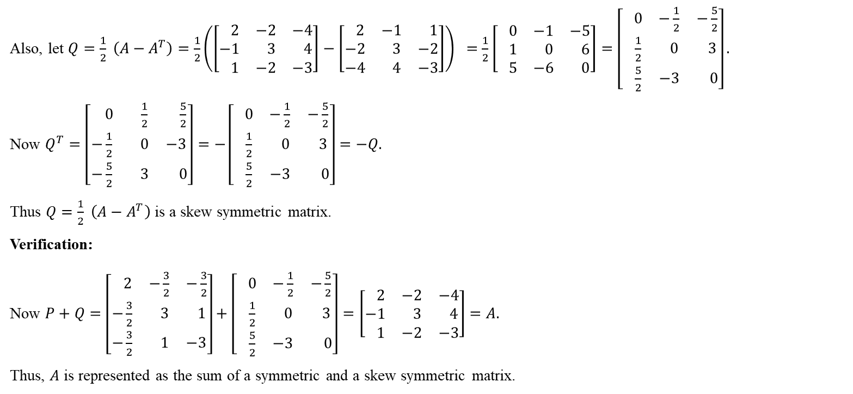
Also, let $Q=\frac{1}{2} \left({A−A}^{T}\right)=\frac{1}{2}\left(\left[\begin{matrix} 2 & −2 & −4 \\ −1 & 3 & 4 \\ 1 & −2 & −3\end{matrix}\right]−\left[\begin{matrix} 2 & −1 & 1 \\ −2 & 3 & −2 \\ −4 & 4 & −3\end{matrix}\right]\right) =\frac{1}{2}\left[\begin{matrix} 0 & −1 & −5 \\ 1 & 0 & 6 \\ 5 & −6 & 0\end{matrix}\right]=\left[\begin{matrix} 0 & −\frac{1}{2} & −\frac{5}{2} \\ \frac{1}{2} & 0 & 3 \\ \frac{5}{2} & −3 & 0\end{matrix}\right].$
Now $Q^{T}=\left[\begin{matrix} 0 & \frac{1}{2} & \frac{5}{2} \\ −\frac{1}{2} & 0 & −3 \\ −\frac{5}{2} & 3 & 0\end{matrix}\right]=−\left[\begin{matrix} 0 & −\frac{1}{2} & −\frac{5}{2} \\ \frac{1}{2} & 0 & 3 \\ \frac{5}{2} & −3 & 0\end{matrix}\right]=−Q.$
Thus $Q=\frac{1}{2} \left({A−A}^{T}\right)$ is a skew symmetric matrix.
Verification:
Now $P+Q=\left[\begin{matrix} 2 & −\frac{3}{2} & −\frac{3}{2} \\ −\frac{3}{2} & 3 & 1 \\ −\frac{3}{2} & 1 & −3\end{matrix}\right]+\left[\begin{matrix} 0 & −\frac{1}{2} & −\frac{5}{2} \\ \frac{1}{2} & 0 & 3 \\ \frac{5}{2} & −3 & 0\end{matrix}\right]=\left[\begin{matrix} 2 & −2 & −4 \\ −1 & 3 & 4 \\ 1 & −2 & −3\end{matrix}\right]=A.$
Thus, $A$ is represented as the sum of a symmetric and a skew symmetric matrix.

Slide 15
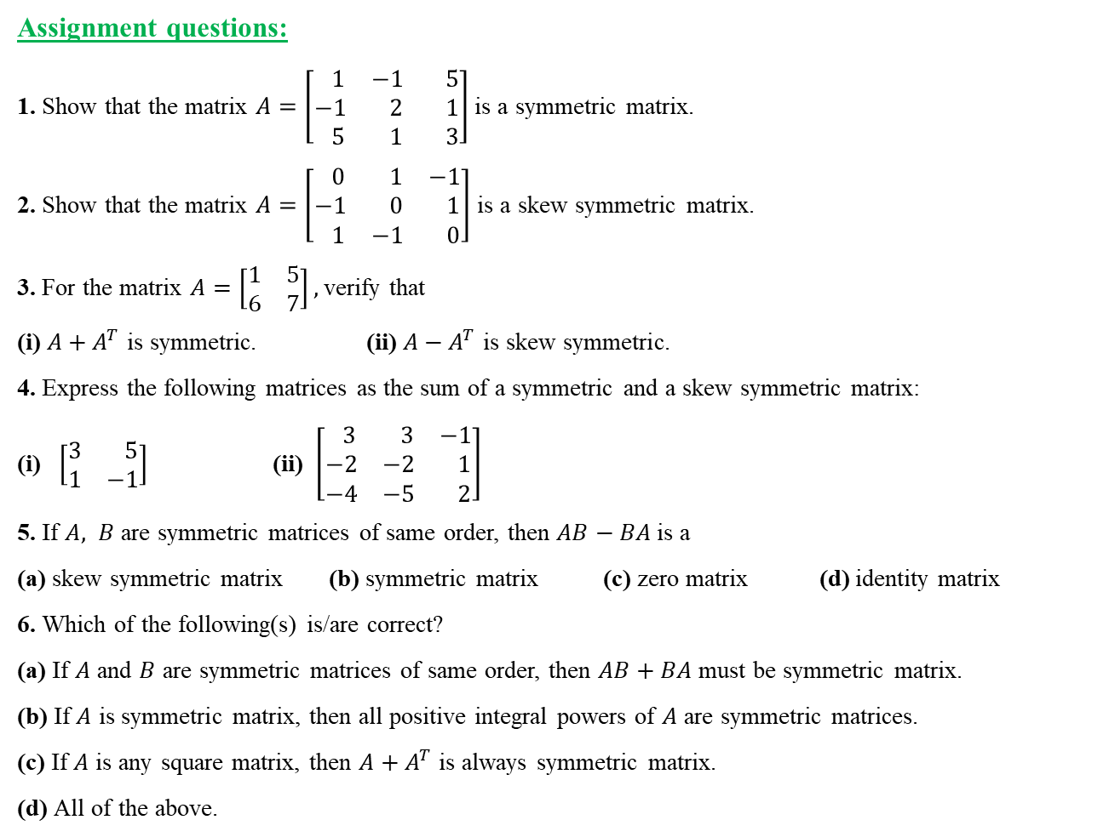
Assignment questions:
1. Show that the matrix $A=\left[\begin{matrix} 1 & −1 & 5 \\ −1 & 2 & 1 \\ 5 & 1 & 3\end{matrix}\right]$ is a symmetric matrix.
2. Show that the matrix $A=\left[\begin{matrix} 0 & 1 & −1 \\ −1 & 0 & 1 \\ 1 & −1 & 0\end{matrix}\right]$ is a skew symmetric matrix.
3. For the matrix $A=\left[\begin{matrix}1 & 5 \\ 6 & 7\end{matrix}\right],$ verify that
(i) ${A+A}^{T}$ is symmetric. (ii) ${A−A}^{T}$ is skew symmetric.
4. Express the following matrices as the sum of a symmetric and a skew symmetric matrix:
(i) $\left[\begin{matrix}3 & 5 \\ 1 & −1\end{matrix}\right]$ (ii) $\left[\begin{matrix} 3 & 3 & −1 \\ −2 & −2 & 1 \\ −4 & −5 & 2\end{matrix}\right]$
5. If $A, B$ are symmetric matrices of same order, then $AB−BA$ is a
(a) skew symmetric matrix (b) symmetric matrix (c) zero matrix (d) identity matrix
6. Which of the following(s) is/are correct?
(a) If $A$ and $B$ are symmetric matrices of same order, then $AB+BA$ must be symmetric matrix.
(b) If $A$ is symmetric matrix, then all positive integral powers of $A$ are symmetric matrices.
(c) If $A$ is any square matrix, then ${A+A}^{T}$ is always symmetric matrix.
(d) All of the above.

Slide 16
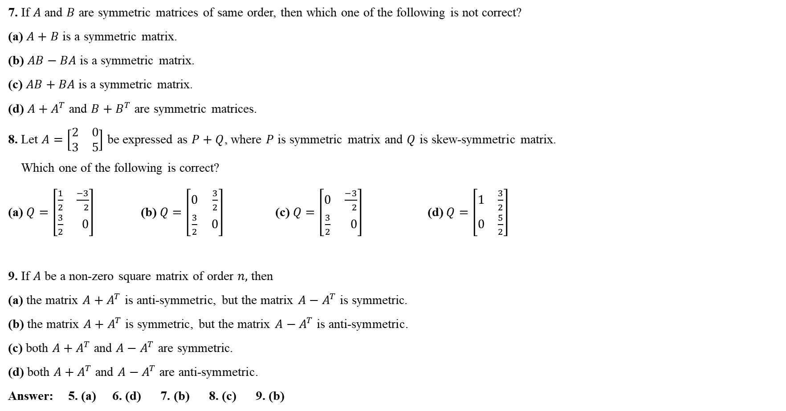
7. If $A$ and $B$ are symmetric matrices of same order, then which one of the following is not correct?
(a) $A+B$ is a symmetric matrix.
(b) $AB−BA$ is a symmetric matrix.
(c) $AB+BA$ is a symmetric matrix.
(d) ${A+A}^{T}$ and ${B+B}^{T}$ are symmetric matrices.
8. Let $A=\left[\begin{matrix}2 & 0 \\ 3 & 5\end{matrix}\right]$ be expressed as $P+Q$, where $P$ is symmetric matrix and $Q$ is skew-symmetric matrix.
Which one of the following is correct?
(a) $Q=\left[\begin{matrix}\frac{1}{2} & \frac{−3}{ 2} \\ \frac{3}{2} & 0\end{matrix}\right]$ (b) $Q=\left[\begin{matrix}0 & \frac{3}{2} \\ \frac{3}{2} & 0\end{matrix}\right]$ (c) $Q=\left[\begin{matrix}0 & \frac{−3}{ 2} \\ \frac{3}{2} & 0\end{matrix}\right]$ (d) $Q=\left[\begin{matrix}1 & \frac{3}{2} \\ 0 & \frac{5}{2}\end{matrix}\right]$
9. If $A$ be a non-zero square matrix of order $n,$ then
(a) the matrix ${A+A}^{T}$ is anti-symmetric, but the matrix ${A−A}^{T}$ is symmetric.
(b) the matrix ${A+A}^{T}$ is symmetric, but the matrix ${A−A}^{T}$ is anti-symmetric.
(c) both ${A+A}^{T}$ and ${A−A}^{T}$ are symmetric.
(d) both ${A+A}^{T}$ and ${A−A}^{T}$ are anti-symmetric.
Answer: 5. (a) 6. (d) 7. (b) 8. (c) 9. (b)

Slide 17
Thank
You

