Slide 1
Vander Waals Forces
by
Dr. Ponchami Sharma
Assistant Professor
Department of Chemistry, Haflong Government College, Dima Hasao-788819, Assam, India

Slide 2
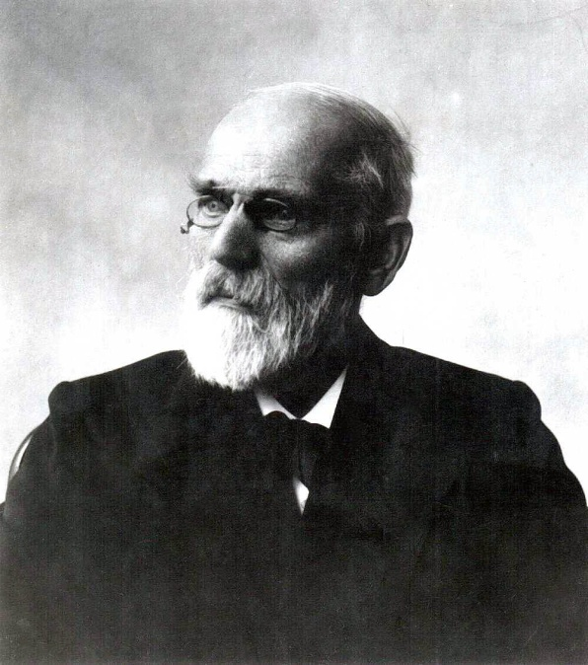
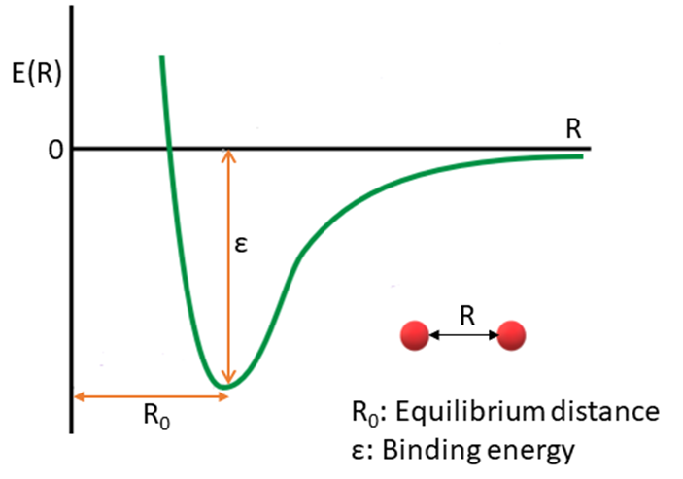
Dutch physicist Johannes Diderik van der Waals, first postulated van der Waals force in 1873
van der Waals force is defined as a distance dependent non-bonding interaction between atoms or molecules. The interaction may also present between ion and molecules.
Main characteristics of van der Waals force:
It is a very weak attractive interaction (< 8 kJ mol⁻¹)
It is a physical interaction, not a chemical bond
It has no directional characteristics
The van der Waals interaction becomes repulsive if the approaching species come closer than a certain distance called contact distance. The repulsion is due to electron-electron repulsion and nuclei-nuclei repulsion of the two species.

Slide 3
Types of van der Waals Force
Ion- Dipole Interaction
Present between ion and polar molecules
Cl⁻
H Cl
δ+
δ-
Chloride Anion
Polar HCl molecule

Slide 4
Types of van der Waals Force
2. Dipole- Dipole Interaction
Present between polar molecules
H Cl
H Cl
δ+
δ-
δ+
δ-
van der Waals Interaction between Polar HCl molecules

Slide 5
Types of van der Waals Force
3. Ion- Induced Dipole Interaction
Present between ion and non - polar molecules
Na⁺
H H
δ-
δ+
Sodium Cation
Non-Polar H₂ molecule
-
+
-
-
+
+
+
-
++++++++
-
+
Induced dipole
+
-
-
+
-
+
A positively-charged rod
-
+
-
+
Positive and negative charges of the sphere separates
A charge-neutral sphere

Slide 6
Types of vander Waals Force
4. Dipole- Induced Dipole Interaction
Present between a polar and a non-polar molecules
H H
H Cl
δ+
δ-
δ+
δ-
Van der Waals Interaction between Polar HCl molecule and induced dipole of H₂ molecule

Slide 7
Types of van der Waals Force
5. Instantaneous Dipole- Induced Dipole Interaction
(London Force)
Present between non-polar molecules
H^{δ+} H^{δ-}
H^{δ+} H^{δ-}
H₂
H₂
van der Waals Interaction between non-polar H₂ molecule
H₂ is non-polar. However, at some instant, there is a probability of finding the two electrons of one H₂ molecular orbital, totally away from the other H₂ molecule. In such case, the first H₂ behaves as dipole which induce its neighboring H₂ molecule to behave as dipole. Thus, a very weak van der Waals force is developed between the two molecules.

Slide 8
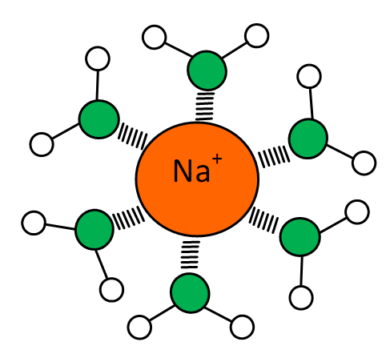
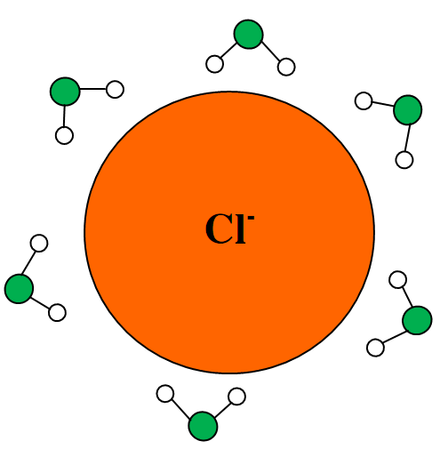
Some Significance of van der Waals force
van der Waals force plays an important role in solvation of solute
e.g. NaCl is soluble in H₂O due to van der Waals force
Ion-Dipole interaction between Na⁺ ion and H₂O molecule
Ion-Dipole interaction between Cl⁻ ion and H₂O molecule
: Oxygen , Hydrogen

Slide 9
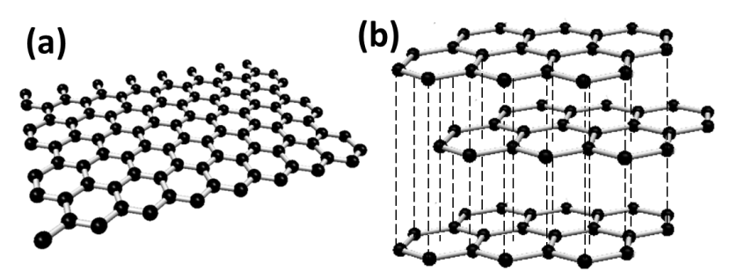
(2) Graphite is made up of stacked layers of graphene hold one over another by van der Waals attraction
(a) Single layer of graphene (b) Layers of graphene hold by van der Waals attraction (London force) to form graphite

