Slide 1
TOPIC:
NANO SCIENCE AND NANO TECHNOLOGY
BY
D. PEGU
ASSOCIATE PROFESSOR, DEPTT. OF PHYSICS
HAFLONG GOVT. COLLEGE, HAFLONG

Slide 2
COURSE CONTENTS:
NANO PHYSICS:
Introduction, Definition, length scale
Importance of Nanoscale and Technology
History of Nanotechnology,
Benefits and challenges in Molecular manufacturing:
Visions and Objective of Nanotechnology,
Nanotechnology in different fields:
Introduction and types of nanoparticles
Techniques of Synthesizing nanoparticles
Characterization of nanoparticles
Toxic effect of Nanoparticles
Transmission Electron Microscope (TEM)

Slide 3
Nanoscience: Study of phenomena and manipulation of materials at atomic, molecular and macromolecular scales, where properties differ significantly from those at a larger scale. Nanotechnology: Design, characterisation, production and application of structures, devices and systems by controlling shape and size on a nanometre scale. Nanomaterial: Object that has at least one dimension on the nanometre scale (app. 1-100 nm); material can be in one dimension (very thin surface coatings, films, layers), in two dimensions (nanowires, nanotubes, fibres) or in all three dimensions (nanoparticles, quantum dots, nanoshells, nanorings, micro).

Slide 4
Various Nanomaterials and
Nanotechnologies
Based on the size and shape, the Nano materials are classified as follows
• Nanotubes
• Nanosprings
• Nanobelts
• Quantum dots
• Nanofluidies
• Nanoparticles
• Nanocapsules
• Nanofibers
• Nanowires
• Fullerenes (carbon 60)

Slide 5
SIZE
A meter is about the distance from the tip of your nose to the end of your hand (1 meter = 3.28 feet).
Millimeter- One thousandth of meter.(10⁻³m)
Micron: a micron is a millionth of a meter (or) one thousandth of millimeter (10⁻⁶m)
Nanometer: A nanometer is one thousandth of a micron (10^{–9}m) (or) a billionth of a meter. ie.,one billion nanometers in a meter.

Slide 6
Composites made from particles of nano-size ceramics or metals smaller than 100 nanometers can suddenly become much stronger than predicted by existing materials-science models.
For example, metals with a so-called grain size of around 10 nanometers are as much as seven times harder and tougher than their ordinary counterparts with grain sizes in the micro meter range.
The Nano particles affects many properties such as
Melting point
Boiling point
Band gap
Optical properties
Electrical properties
Magnetic properties
.Even the structure of materials changes with respect to Size

Slide 7
First, Nanomaterials have a relatively larger surface area when compared to the same mass of material produced in a larger form.
Nano particles can make materials more chemically reactive and affect their strength or electrical properties.
Second, quantum effects can begin to dominate the behaviour of matter at the Nanoscale

Slide 8
Quantum well
It is a two dimensional system
The electron can move in two directions and restricted in one direction.
Quantum Wire
It is a one-dimensional system
The electron can move in one direction and restricted in two directions.
Quantum dot
It is a zero dimensional system
The electron movement was restricted in entire three dimensions

Slide 9
Why Nano Particles ?
Noparticles are of interest because of the new properties (such as chemical reactivity and optical behaviour) that they exhibit compared with larger particles of the same materials.
For example, titanium dioxide and zinc oxide become transparent at the nanoscale and have found application in sunscreens.
Nanoparticles have a range of potential applications:
In the short-term application such as in cosmetics, textiles and paints.
In the longer term applications such as drug delivery where they could be to used deliver drugs to a specific site in the body.
Nanoparticles can also be arranged into layers on surfaces, providing a large surface area and hence enhanced activity, relevant to a range of potential applications such as catalysts.

Slide 10
1. Nanotechnology Applications in Medicine
Because of their small size, nanoscale devices can readily interact with biomolecules on both the surface of cells and inside of cells.
By gaining access to so many areas of the body, they have the potential to detect disease and the deliver treatment.
Nanoparticles can can deliver drugs directly to diseased cells in your body.
Nanomedicine is the medical use of molecular- sized particles to deliver drugs, heat, light or other substances to specific cells in the human body.

Slide 11
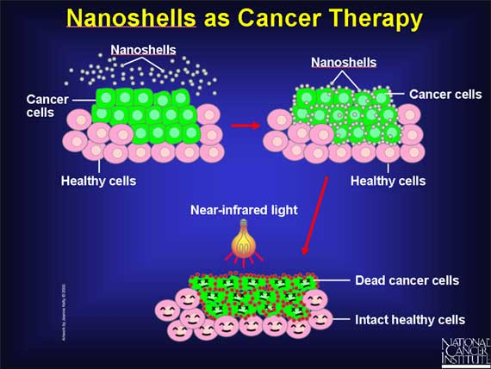
Nano shells as Cancer Therapy
Nano shells are injected into cancer area and they recognize cancer cells. Then by applying near-infrared light, the heat generated by the light-absorbing Nano shells has successfully killed tumor cells while leaving neighboring cells intact.

Slide 12
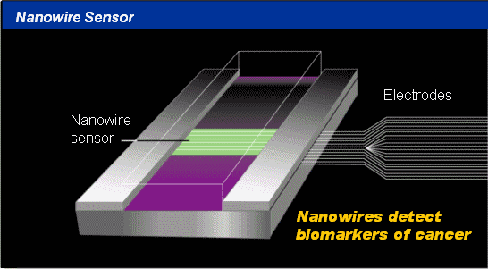
Nanowires – used as medical sensor
In this diagram, Nano sized sensing wires are laid down across a micro fluidic channel. As particles flow through the micro fluidic channel, the Nanowire sensors pick up the molecular identifications of these particles and can immediately relay this information through a connection of electrodes to the outside world.
These Nanodevices are man-made constructs made with carbon, silicon Nanowire.
They can detect the presence of altered genes associated with cancer and may help researchers pinpoint the exact location of those changes

Slide 13
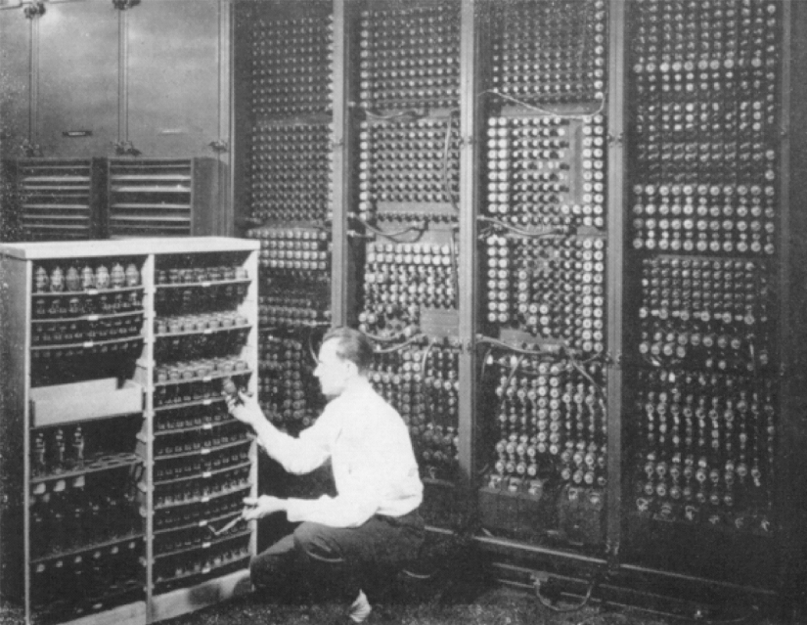

2. Nano Computing Technology
Past
Shared computing thousands of people sharing a mainframe computer
Present
Personal computing
Future
Ubiquitous computing thousands of computers sharing each
and everyone of us; computers embedded in walls, chairs, clothing,
light switches, cars….; characterized by the connection of things in
the world with computation.

Slide 14
3. Sunscreens and Cosmetics
Nanosized titanium dioxide and zinc oxide are currently used in some sunscreens, as they absorb and reflect ultraviolet (UV) rays.
Nanosized iron oxide is present in some lipsticks as a pigment.
4. Fuel Cells
The potential use of nano-engineered membranes to intensify catalytic processes could enable higher-efficiency, small-scale fuel cells.
5. Displays
Nanocrystalline zinc selenide, zinc sulphide, cadmium sulphide and lead telluride are candidates for the next generation of light-emitting phosphors.
CNTs are being investigated for low voltage field-emission displays; their strength, sharpness, conductivity and inertness make them potentially very efficient and long-lasting emitters.

Slide 15
6. Batteries
With the growth in portable electronic equipment (mobile phones, navigation devices, laptop computers, remote sensors), there is great demand for lightweight, high-energy density batteries.
Nanocrystalline materials are candidates for separator plates in batteries because of their foam-like (aerogel) structure, which can hold considerably more energy than conventional ones.
Nickel–metal hydride batteries made of nanocrystalline nickel and metal hydrides are envisioned to require less frequent recharging and to last longer because of their large grain boundary (surface) area.
7. Catalysts: In general, nanoparticles have a high surface area, and hence provide higher catalytic activity.

Slide 16
8. Magnetic Nano Materials applications
It has been shown that magnets made of nanocrystalline yttrium–samarium–cobalt grains possess unusual magnetic properties due to their extremely large grain interface area (high coercivity can be obtained because magnetization flips cannot easily propagate past the grain boundaries).
This could lead to applications in motors, analytical instruments like magnetic resonance imaging (MRI), used widely in hospitals, and microsensors.
Nanoscale-fabricated magnetic materials also have applications in data storage.
Devices such as computer hard disks storage capacity is increased with Magnetic Nano materials

Slide 17
9. Medical Implantation
Unfortunately, in some cases, the biomedical metal alloys may wear out within the lifetime of the patient. But Nano materials increases the life time of the implant materials.
Nanocrystalline zirconium oxide (zirconia) is hard, wear resistant, bio-corrosion resistant and bio-compatible.
It therefore presents an attractive alternative material for implants.
Nanocrystalline silicon carbide is a candidate material for artificial heart valves primarily because of its low weight, high strength and inertness.
.
10. Water purification
Nano-engineered membranes could potentially lead to more energy-efficient water purification processes, notably in desalination process.

Slide 18
11. Military Battle Suits
Enhanced nanomaterials form the basis of a state-of- the-art ‘battle suit’ that is being developed.
A short-term development is likely to be energy-absorbing materials that will withstand blast waves;
longer-term are those that incorporate sensors to detect or respond to chemical and biological weapons (for example, responsive nanopores that ‘close’ upon detection of a biological agent).

Slide 19
THANK YOU

