Slide 1
SOFT SKILLS
(AECC)
Dinesh Tiwari
Associate Professor,
Dept. of English, HGC.

Slide 2
Soft Skills: Defined
Soft skills refer to a cluster of personal qualities, habits, attitudes and social graces that make someone a good employee and compatible to work with.
Unlike hard skills, which tend to be specific to a certain type of task, soft skills are broadly applicable.

Slide 3
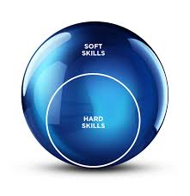

Slide 4


Soft Skills: Examples of
Interpersonal Attributes
Interpersonal abilities
  Empathy
  Leadership
  Communication
  Teamwork
  Good manners
  Ability to teach
  Works well with diversity
  Self-confidence

Slide 5

Soft Skills: Examples of
Personal Attributes
Personal Attributes:
  Optimism
  Responsibility
  Sense of humor
  Integrity
  Time management
  Motivation
  Common Sense
It’s often said that hard skills will get you an interview but you need soft skills to get (and keep!) the job.

Slide 6

IQ
We live in a society that measures intelligence (IQ) through quantifiable metrics
  You complete the assignments, come to class, learn the concepts, and you get an “A”

Slide 7

EI
In the workplace, most compliments will deal more with the use of soft skills (EI – Emotional Intelligence) than your actual knowledge about a particular situation.
  Customers appreciate a “willingness to help” or the fact that you “listened to my complaint.”

Slide 8

Good Soft Skills….
Will help you STAND OUT in a crowd of mediocrity.
What makes
you stand out???

Slide 9

Employability
It’s the soft skills that employers look for when hiring employees.
Do you have these skills?

Slide 10

Courtesy
Good Manners
Considerate Behavior
Polite
Being kind & empathetic
Thank you notes!

Slide 11
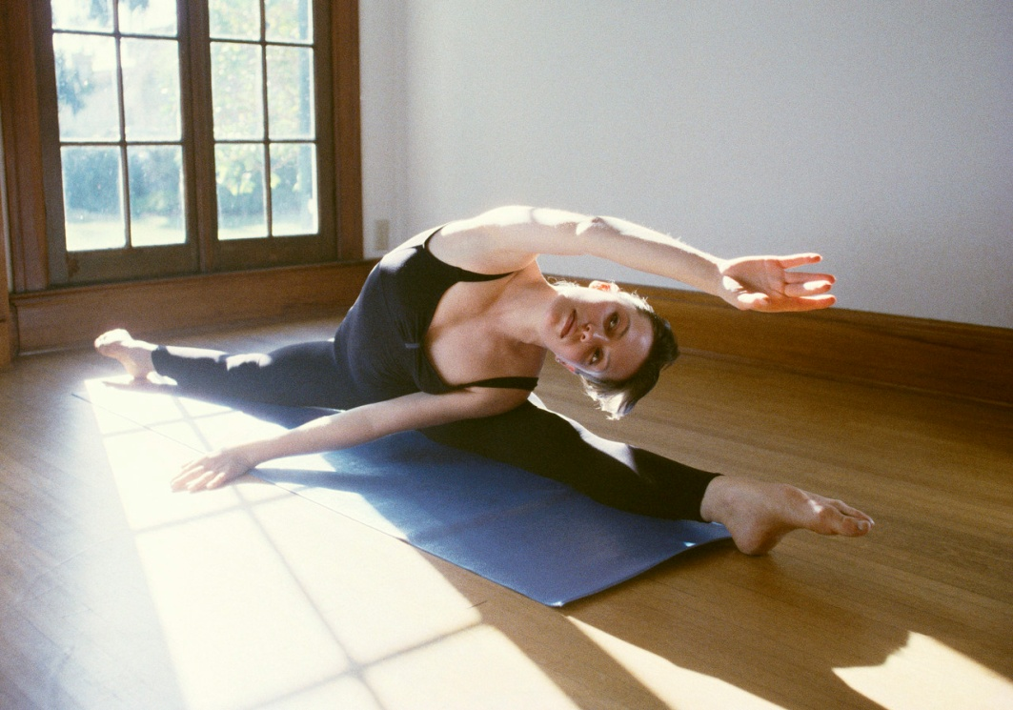
Flexibility
The ability to adapt to new situations quickly
The ability to change or be changed according to situations or circumstances

Slide 12
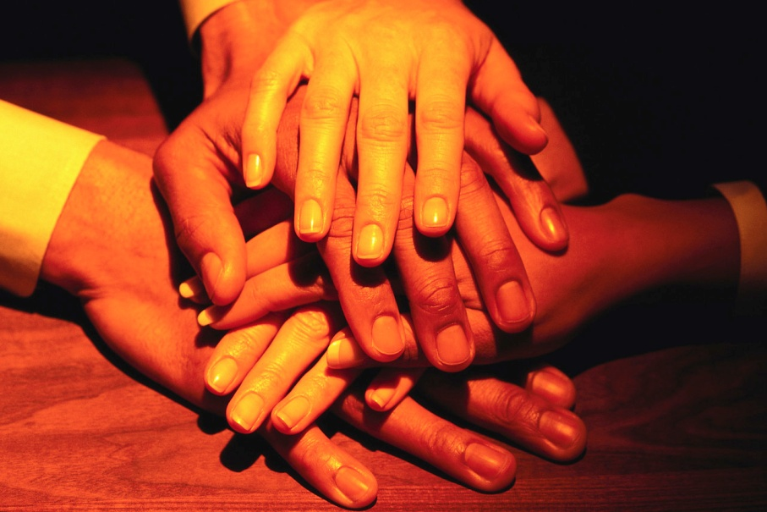
Team Skills
Do you know how to work effectively in groups?
Do you listen effectively?
Do you understand the value of diverse thought?

Slide 13



Eye Contact
Looking directly into the eyes of someone

Slide 14

Positive Work Ethic & Attitude
If you have a great work ethic but a negative attitude, which one do you think will trump the other?
Belief in the moral value of work

Slide 15
Interpersonal Skills &
Personal Chemistry
Interpersonal Defined: of or pertaining to the relations between persons
Personal Chemistry: Do others want to be with you?

Slide 16

Common Sense
Good judgment – sound practical judgment based on “experience” rather than theory

Slide 17

Good Personal Appearance
Visual aspect of a person – with regards to personal cleanness and neatness of clothing

Slide 18

Understanding What the
World is About
(What’s going on in the News?)
Know what’s going on
Even Yahoo! News is better than no news
Get connected, know what others are doing. Subscribe to Inc. or Fast Company.
Track a few stocks

Slide 19

Willingness to take instruction and responsibility
Do you know someone who always blames others?
Do you know someone who thinks he/she already knows all the answers?

Slide 20
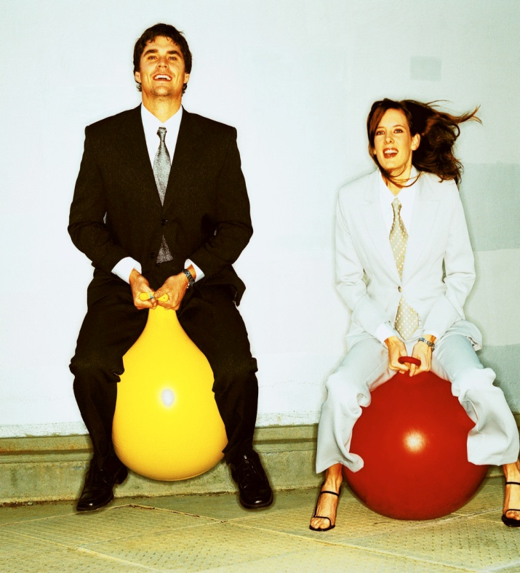
Able to Relate to co-workers in a close environment
Connection with people or things
Water cooler talk
Business retreats
Team Activities

Slide 21

Not expecting to be promoted within the first six months
“This is just a stepping stone for me”
Examples?

Slide 22
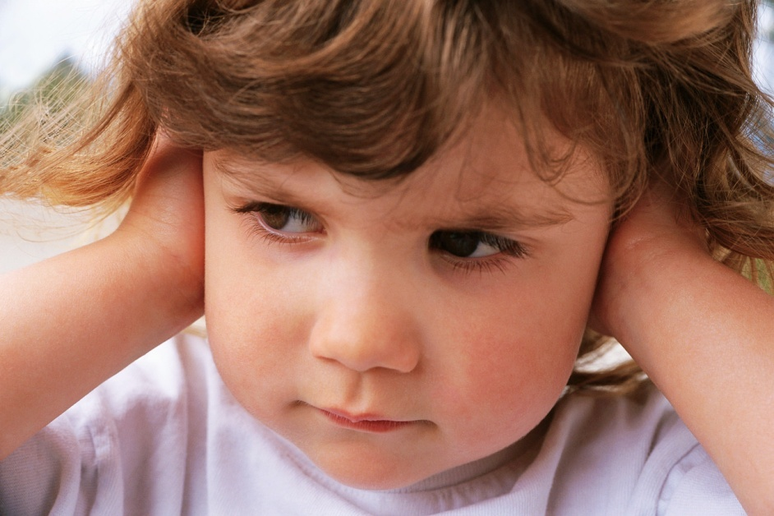
Communication skills with public, fellow employees, supervisors, and customers
Are you a good listener?
  How many of you have had a good boss?
Telephone line…don’t
count on its working!
Networking within your business? How?

Slide 23


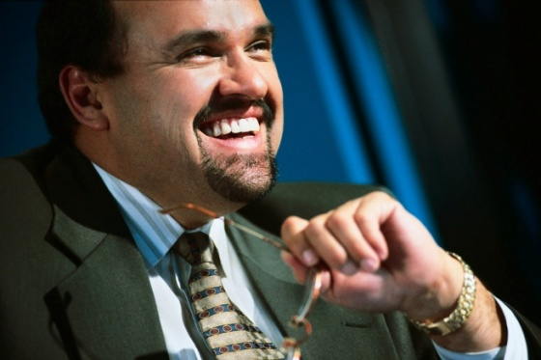
Soft Skills
One of the most difficult things to teach
And…the most common reason for not hiring, not promoting, & poor performance evaluation
Pick one skill…work on it….PRACTICE!

Slide 24
THANK YOU

