Slide 1
Course No. CHMDSC101/CHMGEC101
UNIT-2
Lattice Energy and Born-Haber Cycle
Dr. Sankar Neogi
Associate Professor & Head
Department of Chemistry
Haflong Govt. College, Haflong

Slide 2
Overview
Chemical Bond
Ionic Bond
Crystal
Ionic Crystal
Types of Ionic Crystal
Lattice Energy
Born-Haber Cycle

Slide 3
Chemical Bond
A CHEMICAL BOND IS DEFINED AS A FORCE OF ATTRACTRATION WHICH HOLDS TOGETHER THE CONSTITUTENT ATOMS IN A MOLECULE

Slide 4
Types of Chemical Bond
Three main types of Chemical bonds.
Electrovalent bond or Ionic bond involves the transfer of electrons and is usually observed when a metal bonds to a nonmetal.

Slide 5
Contn…..
Covalent bond involves the sharing of electrons and is usually observed when a nonmetal bonds to a nonmetal.
Coordinate bond or Dative bond involves the transfer of electrons and occurs when a nonmetal bonds to another nonmetal.

Slide 6
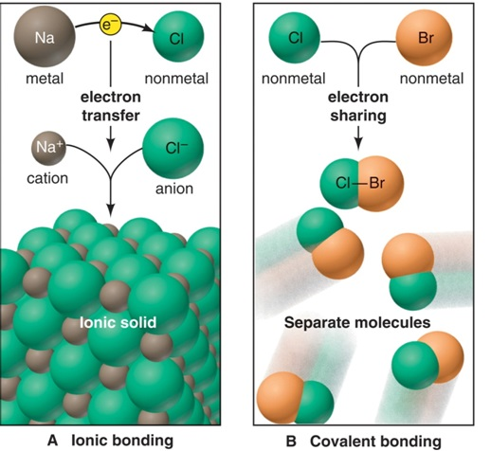
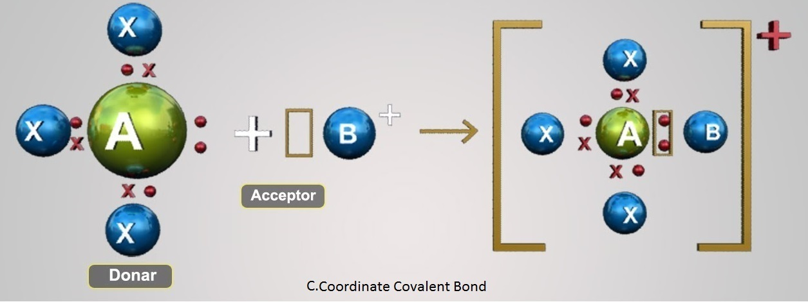
Three models of chemical bond

Slide 7
The Ionic Bonding Model
An ionic bond is formed when a metal transfers electrons to a nonmetal to form ions, which attract each other to give a solid compound.
The total number of electrons lost by the metal atom(s) equals the total number of electrons gained by the nonmetal atoms.

Slide 8
Three ways to depict electron transfer in the formation of Li⁺ and F⁻.
Electron configurations
Li 1s²2s¹ + F 1s²2p⁵ → Li⁺ 1s² + F⁻ 1s²2s²2p⁶
Orbital diagrams
Li
↑↓
↑
↑↓
Li⁺
+
1s
2s
2p
1s
2s
2p
F
↑↓
↑↓
↑↓
↑↓
↑
F⁻
↑↓
↑↓
↑↓
↑↓
↑↓
1s
2s
2p
1s
2s
2p
Lewis electron-dot symbols
••
••
-
Li
•
F
Li⁺ +
F
•
••
••
••
••
••

Slide 9
Crystals

Slide 10
Crystal Structures
Atoms (and later ions) will be viewed as hard spheres. In the case of pure metals, the packing pattern often provides the greatest spatial efficiency (closest packing).
Ionic crystals can often be viewed as a close-packed arrangement of the larger ion, with the smaller ion placed in the “holes” of the structure.

Slide 11
Unit Cells
A unit cell of the crystal is an imaginary parallel-sided region from which the entire crystal can be built up.
Usually the smallest unit cell which exhibits the greatest symmetry is chosen. If repeated (translated) in 3 dimensions, the entire crystal is recreated.

Slide 12
Ionic Crystals
Ionic Crystals in which the units are positively and negatively charged ions occupy the lattice points.
Ionic Crystals are of the type AX (e.g NaCl, LiF, etc.), AX₂(CaCl₂) or A₂X (Na₂S)

Slide 13
Lattice Energy
The Lattice energy (U) of an ionic crystal is defined as the amount of energy released when cations and anions in their gaseous states are brought from infinity to their respective lattice sites in a crystal to form one mole of the ionic crystal
A⁺(g) + B⁻(g) ^{– U} A⁺B⁻(s); U=Latice energy

Slide 14
Periodic Trends in Lattice Energy
Lattice energy is the energy required to separate 1 mol of an ionic solid into gaseous ions.
Lattice energy is a measure of the strength of the ionic bond.
Coloumb’s Law
Electrostatic energy ∝
charge A x charge B
distance
Electrostatic energy ∝
cation charge x anion charge
cation radius + anion radius
∝ ΔHº_{lattice}

Slide 15
Periodic Trends in Lattice Energy
Lattice energy is affected by ionic size and ionic charge.
As ionic size increases, lattice energy decreases. Lattice energy therefore decreases down a group on the periodic table.
As ionic charge increases, lattice energy increases.

Slide 16
Born-Haber Cycle
  Direct experimental determination of lattice energies is not so easy
  Lattice energies are determined indirectly with the help of a thermo-chemical cyclic process known as Born-Haber cycle

Slide 17
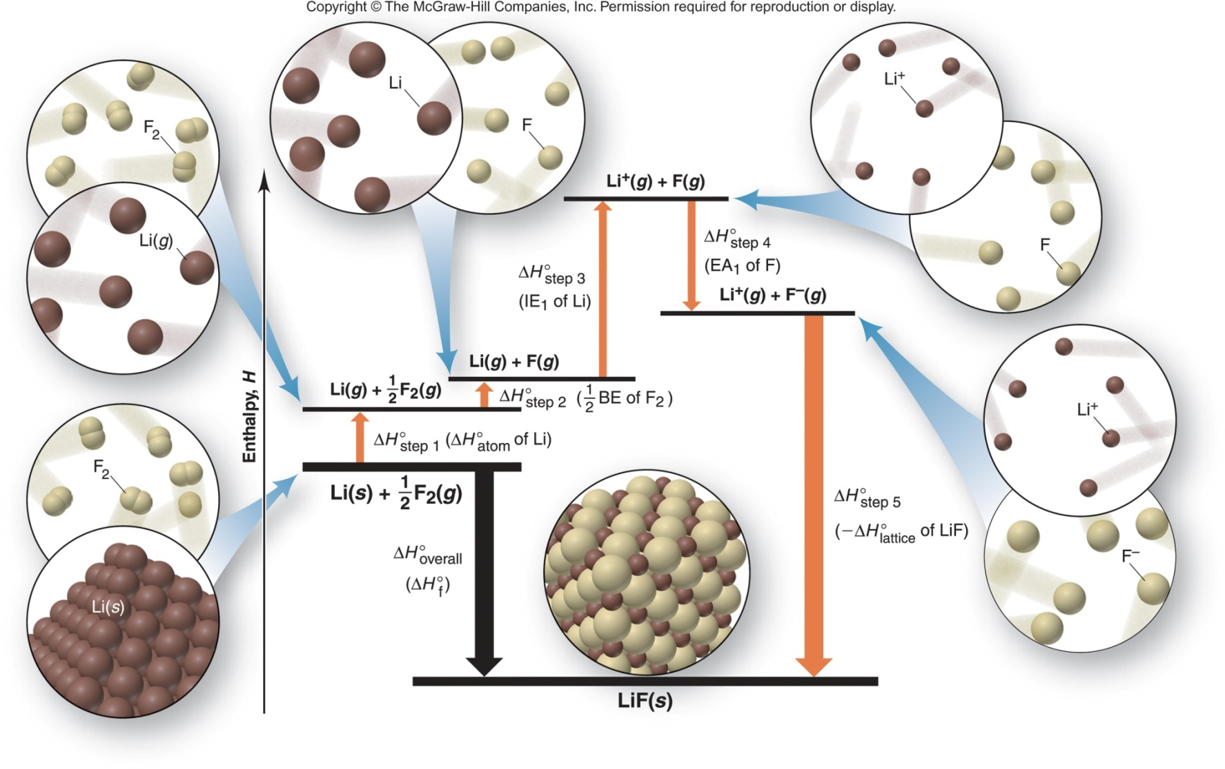
The Born-Haber cycle for lithium fluoride.

Slide 18
Contn….

Slide 19
Contn…..
For a reaction such as
Na(s) + ½ Cl₂(g) → NaCl(s) we want to decide if the compound will be stable as an ionic salt.
The customary way of doing this is to use a thermodynamic cycle (an application of Hess’s Law). In this case the cycle is known as the Born-Haber Cycle

Slide 20
Na⁺(g)
+
Cl⁻(g)
IE
EA
Na(g)
Cl(g)
ΔH_{sub}
½ BDE
Lattice Energy (U)
ΔH_{f}
Na(s) + ½ Cl₂(g) NaCl(s)

Slide 21
Contn…..
By knowing the value of all the other terms, including ΔH_{f}, then Lattice energy (U)can be calculate from the equation
U = ΔH_{f} – (ΔH_{sub} + IE + ½ BDE + EA)
Without the value of ΔH_{f} , U can be estimated by several methods
  the Born equation
  the Born-Meyer equation
  the Kapustinski equation

Slide 22
End

